Slide 1
The 11th Australian Conference on Life Cycle Assessment
July 20th, 2023
Future greenhouse gas emissions from metal production with implication for climate goals
Ryosuke YOKOI¹, Takuma WATARI², Masaharu MOTOSHITA¹
¹National Institute of Advanced Industrial Science and Technology (AIST), Japan
²National Institute for Environmental Studies, Japan

Slide 2
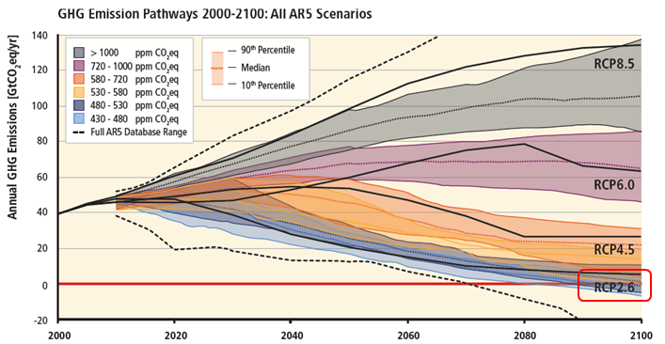
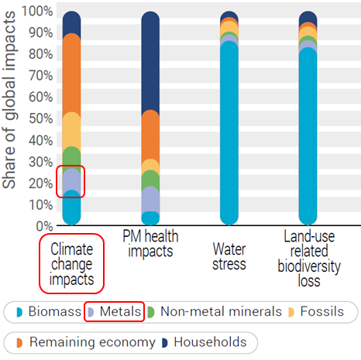
Climate goals and metal production
2℃ target (The Paris Agreement, 2015) → aim to limit global temperature increase below 2℃ compared to pre-industrial levels (RCP2.6)
Metals are essential resources for decarbonization → At the same time, their production accounts for 10% of global greenhouse gas (GHG) emissions
Metal demand will increase due to population and economic growth and decarbonization technology.
IPCC (2014)
Concerns for limitation of future metal use
Reducing future GHG emissions from metal production
IRP (2019)

Slide 3
Purposes
Future metal demand projection - How will metal demand change due to population and economic growth under different socio-economic scenarios?
Future GHG emissions from metal production - Can we achieve the climate goal for metal production? - Which measures will be effective to reduce GHG emissions from metal production?
*Analysis was conducted for six metals → Aluminum, Copper, Iron, Lead, Nickel, Zinc

Slide 4
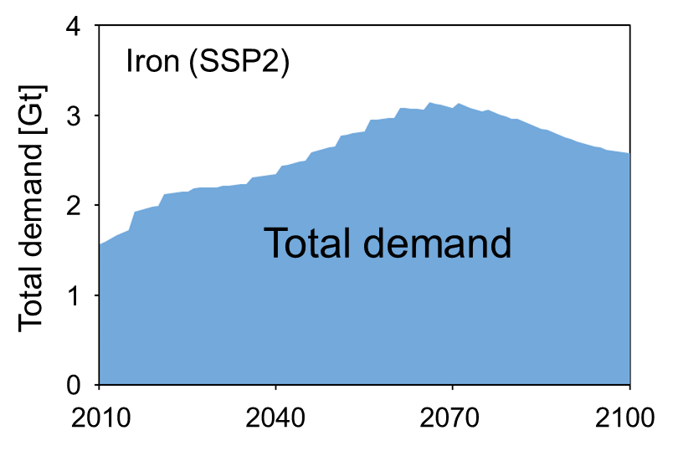
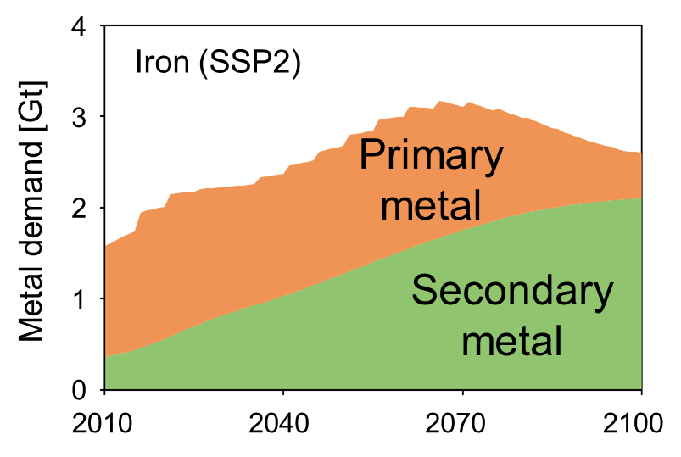
Methods (overview)
Watari and Yokoi, Resour. Policy, 2021
*Shared Socioeconomic pathways
Life cycle assessment
Van der Voet et al., J. Ind. Ecol., 2018
Historical in-use metal stocks for each countries
SSPs*
GHG emission intensity
Previous study
Population, GDP, Energy mix
Logistic curve modelling
Material flow analysis
[Al, Cu, Fe, Pb, Ni, Zn]
Future demand
Primary/Secondary metal production
GHG emissions from metal production(2010-2100)
Recycling rate
Lifetime
Yield rate
Scenario analysis
Comparison
Climate goal (RCP2.6_Industrial sector)

Slide 5
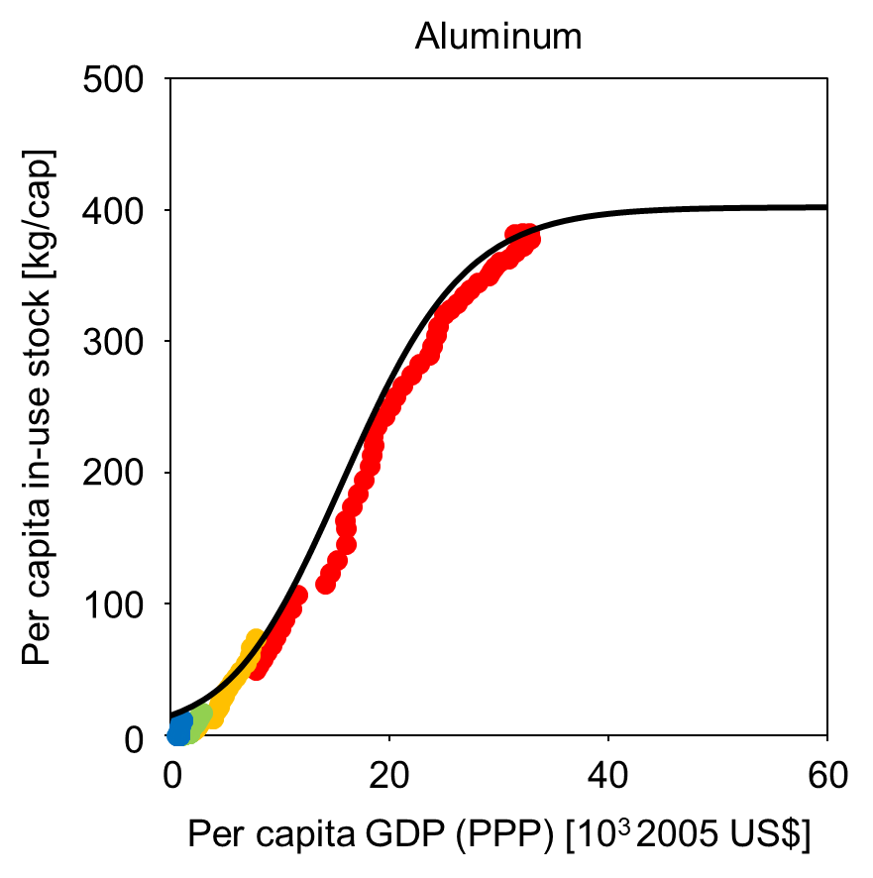
Approach (future metal demand projection)
<Stock saturation approach>
Project future metal stock growth → Calculate future metal demand
Extraction
Production (primary/secondary)
Use (metal stock)
Waste management
Landfill
Recycling
Metal stock per capita do not increase infinitely but will eventually saturate at a certain level
Developing countries will follow the stock growth patterns of developed countries
High income
Upper Middle income
Lower Middle income
Low income

Slide 6
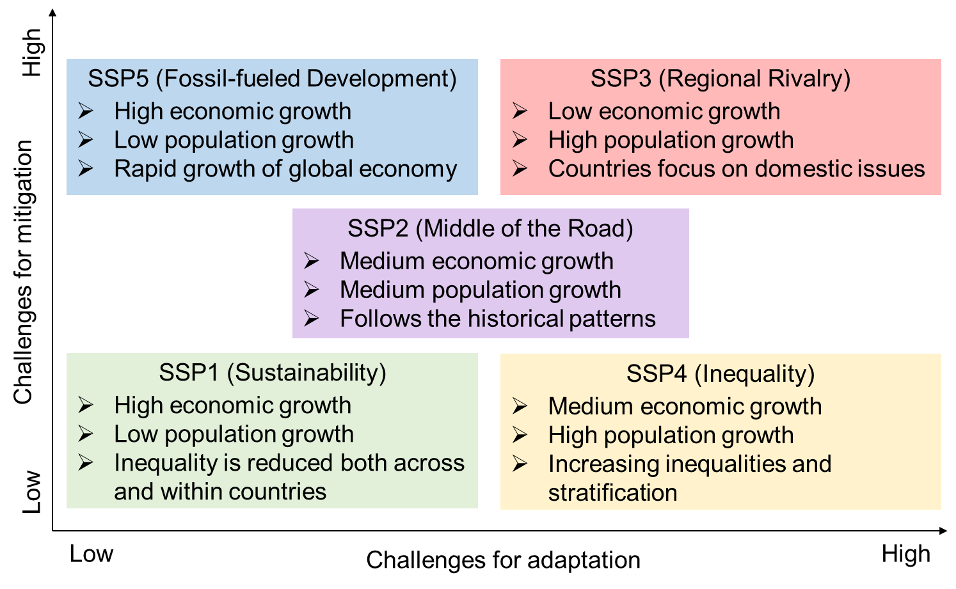
*Shared Socio-economic Pathways (SSPs)
Future scenarios that provide quantitative and qualitative description of future socio-economic situations
Population
Economic growth (GDP)
Electricity mix

Slide 7
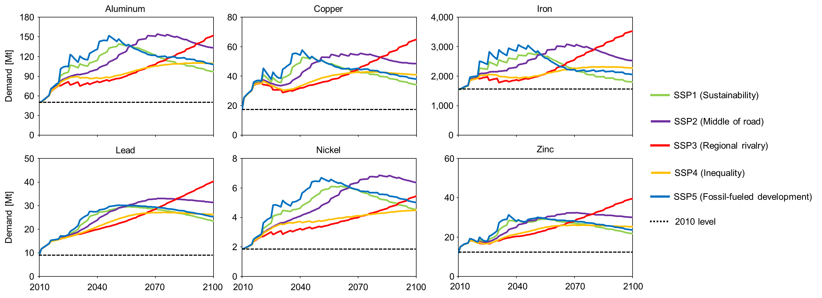
(Yokoi et al. 2022)
Future metal demand
Population and economic growth lead to significant increase in demand (larger than the current level throughout 21st century) (maximum by 2.3–4.4 times)
Different trends among SSPs → Peak until 2050 and then decline (SSP1, 5), continue to increase (SSP3)

Slide 8
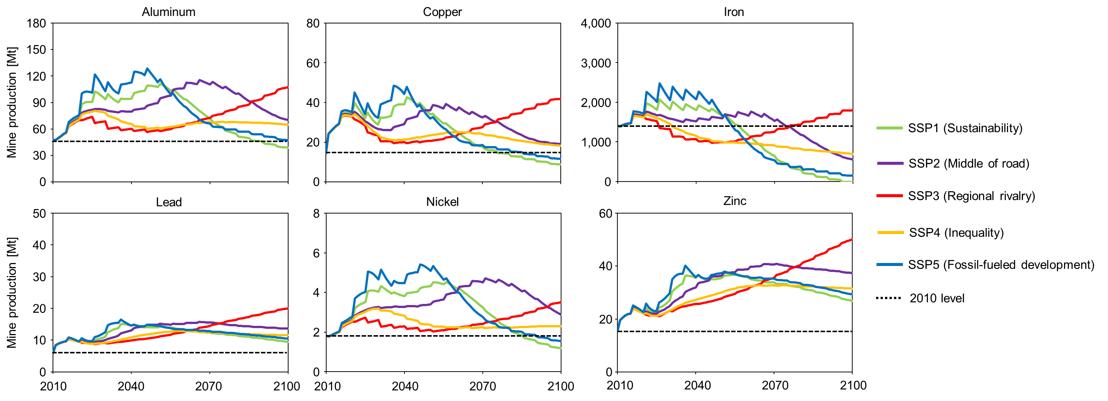
Future mine production
Increasing metal stocks (waste flow) increase recycling, leading to decrease in mine production
Different trends among metals → Stock growth pattern, recycling rate

Slide 9
GHG emissions from metal production
GHG emissions is mainly attributed to iron production (the share will decrease)
Increase in GHG emissions especially in the early century driven by population and economic growth in middle-income countries.
SSPs have a great effect on GHG emissions, but no SSP can achieve the climate goal
Further efforts are required to achieve the climate goal

Slide 10
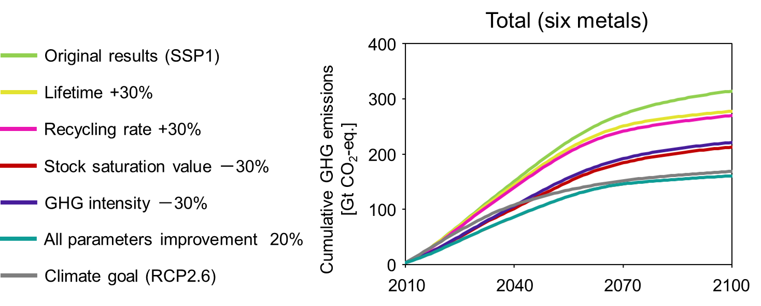
How can we reduce GHG emissions from metal production?
Saturation value of stock per capita
GHG emission intensity
Product lifetime
Recycling rate
Metal use level
Improving recycling rate will be effective in the long-term
Emission intensity and metal use level can be key factors
Improving all parameters will be required
Improving a single parameter is insufficient to achieve the climate goal
Sustainable socio-economic pathway and multiple measures are essential
Can we improve these parameters?

Slide 11
Reducing metal use level (stock level)
Per capita metal stock level in high-income level countries (iron)
-10%→2002 (9.6 ton), -20%→1993 (8.5 ton), -30%→1980 (7.5 ton)
Should we go back to the past level?
$$\frac{Metal stock}{Population} = \frac{Metal stock}{Service (extant)} × \frac{Service (extant)}{Service (utilized)} × \frac{Service (utilized)}{Population}$$
Stock productivity (reciprocal)
Service utilization rate (reciprocal)
Per capita service demand
Weight saving
Material substitution
Utilizing underused infrastructure and buildings
Sharing economy
Product service systems
Consumer behavior
Living standard
Technological improvement
Systematic improvement
Lifestyle, Living standard

Slide 12
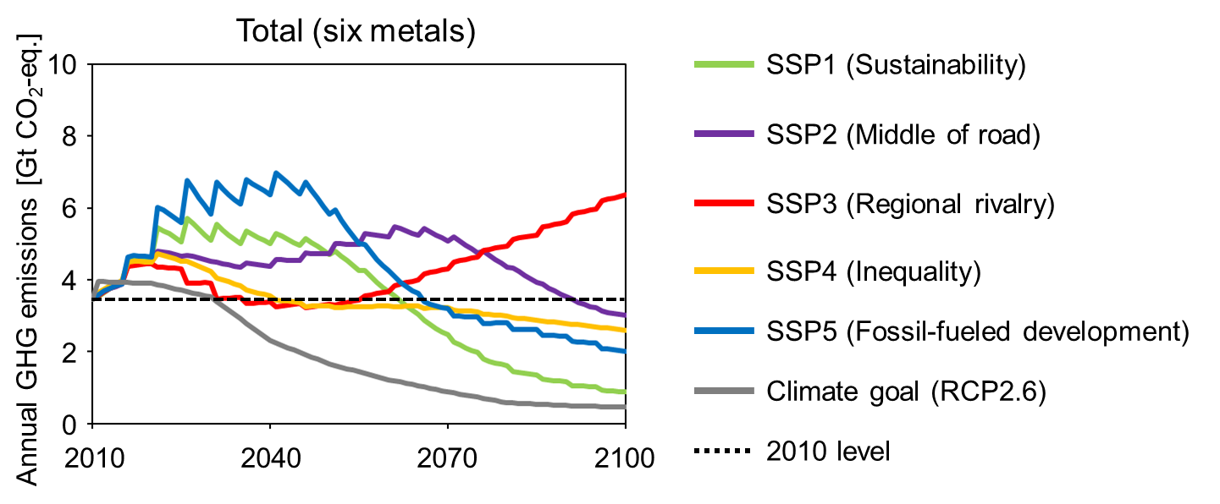
Reducing emission intensity of primary iron production
<Emission intensity of primary iron production>
Energy transition is not enough because GHG emissions are mainly due to reduction process with coke
Hydrogen reduction
BF-BOF + CCUS
BF-BOF: Blast furnace-basic oxygen furnace CCUS: Carbon dioxide capture, utilization and storage
Increase in GHG emissions especially in the early century
Prompt actions are essential

Slide 13
Summary
Future demand projection for six metals (Al, Cu, Fe, Pb, Ni, Zn)
Population and economic growth will cause significant increase in metal demand and mine production
Future GHG emissions from metal production
Socio-economic pathways (SSPs) have a great effect on GHG emissions → However, no SSP will achieve the climate goal (2℃ target) for metal production
Energy transition is effective but will be insufficient for achieving the climate goal → For primary iron production, additional technological development (e.g., hydrogen reduction, CCUS) is required
In addition to following the sustainable socio-economic pathway, implementing multiple measures immediately with international cooperation is essential
Yokoi, R., Watari, T., Motoshita, M., 2022. Future greenhouse gas emissions from metal production: gaps and opportunities towards climate goals. Energy Environ. Sci. 15, 146–157.

